Slide 1

Session 6: Vulnerabilities
Tommy Morris
Professor, Electrical and Computer Engineering
Director, Center for Cybersecurity Research and Education
University of Alabama in Huntsville

Slide 2


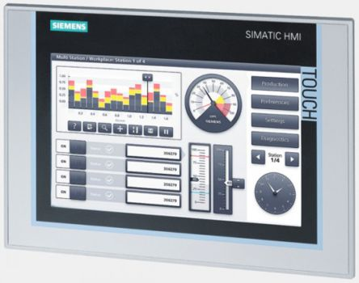
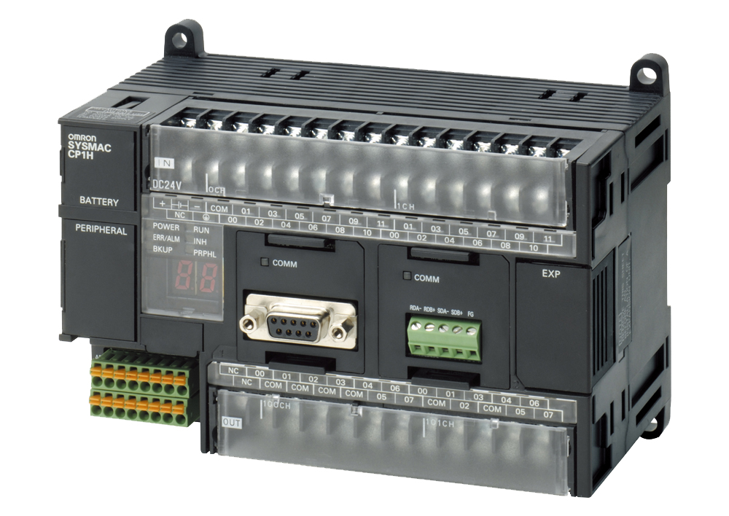
Network Attack Overview
Most SCADA networks have little to no authorization, making it easy for an attacker to access the network
Attacks often occur between the PLC and the HMI
Called “Man in the Middle” (MitM) because attacker gets in middle of connection
Can be difficult to detect until it’s too late
Information on screen may seem plausible to operator
Attacker
Actuator Data
Sensor Info
Physical System
PLC
HMI

Slide 3

Interception/Reconnaissance
Attacker gains access to the network and can see information
Does not modify or block packets, just observes
Can learn system functions, commands, addresses, etc.
Attacker
Command to turn on pump
Temperature sensor readings
PLC
HMI

Slide 4
Injection
Attacker sends their own commands or false data to the system
Request data
Turn system functions off
Send fake sensor readings to HMI
With no authentication method, PLC and HMI won’t know it isn’t legitimate information
Attacker
Increase pump pressure
Pipeline pressure is normal
PLC
HMI

Slide 5
Alteration
Attacker modifies the contents of existing packets
Order of events:
Intercept legitimate packet
Block the original from going through
Modify packet
Send changed packet
Attacker
Temperature is normal
Warning: temp too high
PLC
HMI

Slide 6
Interruption
Attacker disrupts service between devices
Can overwhelm device with packets, such as ping requests
Denial of Service (DoS) will be covered for next lab
In MitM, attacker can masquerade as other device
Sender doesn’t realize it isn’t communicating with intended recipient
Recipient never receives any data
Attacker
Battery is low
PLC
HMI
Notes:
ARP (address resolution protocol) is used for routing
Attacker can “poison” the ARP cache of the sender, so it thinks the attacker is the one it wants to send to
This makes all packets from sender to intended recipient route through attacker
Discussed more in Lab Four

Slide 7
Attacking the instructor
This exercise will introduce the concepts of Denial of Service (DoS) and Distributed Denial of Service (DDoS). Both techniques have the purpose of taking a target down by flooding the target with a large amount of data in a short time. The Low Orbit Ion Cannon (LOIC) will be used to perform the attacks for this exercise.
All students will target the heat exchanger PLC running on the lecturer’s computer. At first, only one student at a time will be allowed to attack the simulation (DoS). Then, all students in the class will perform the attack at the same time (DDoS).
Download LOIC from and extract the contents of the zip file on a folder.
Open LOIC.exe. On the main window, insert the target IP and click on Lock on.
Under “Attack options” type 502 on port, select Method “TCP”, type 1000 in Threads, and uncheck the “Wait for reply” option.
Click on “CHARGING MY LASER” and observe the results on the lecturer computer.

Slide 8
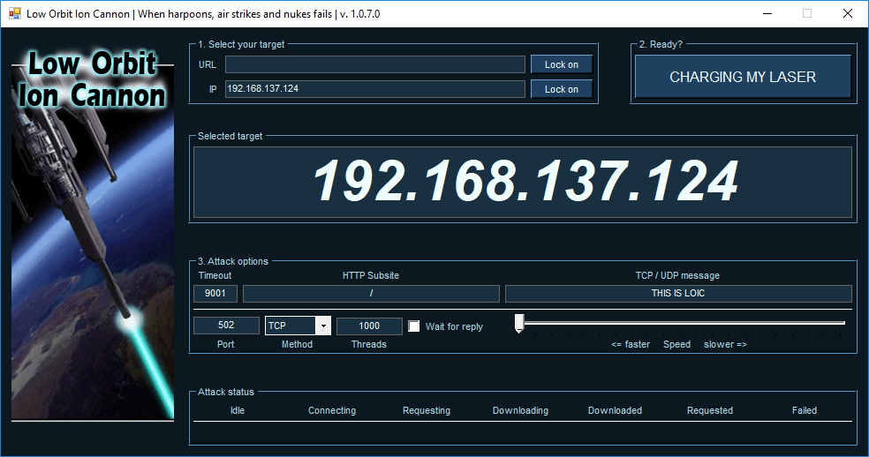
Attacking the Instructor

Slide 9
INJECTION Attacks
On this exercise students will perform an injection attack by fabricating messages with different settings and sending them to the target PLC. Students will use the Radzio! software to fabricate the messages. The target will be the heat exchanger PLC running on the lecturer’s computer. At first, only one student at a time will be allowed to attack the simulation. Then, all students in the class will perform the attack at the same time.
Download Radzio! from here and extract the contents of the zip file on a folder.
Open RMMS.exe. On the main window, go to Connection->Settings. Select Modbus TCP under “Protocol”, Register address starting from 0 under “Addressing convention”, and type the target PLC address on “IP address: “ field. Also, make sure that the TCP port is 502.

Slide 10
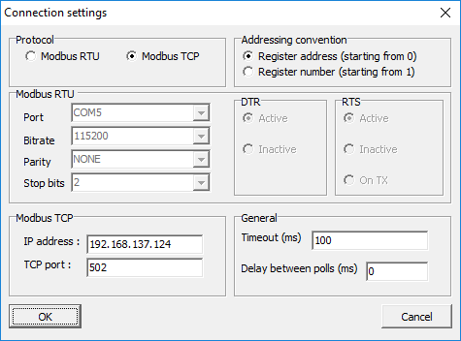
INJECTION ATTACKS

Slide 11
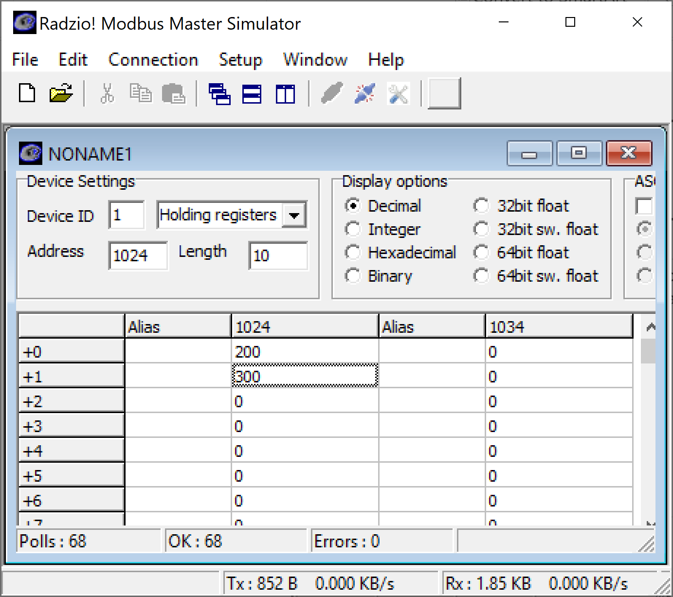
Injection Attacks
Click on File->New and Connection->Connect. On the new spreadsheet that appears, select Holding registers to view the PLC memory data.
Change the address to 1024
The values displayed are the number1 and number2 fields for the advanced HMI problem.
Double click on the first value and change it to be larger than the second number.
The light should come one.

Slide 12
INJECTION ATTACKS
Overwrite the memory used to store the enable blinking LED.
ENABLE and DISABLE the LED from Radzio
Overwrite the memory used for the button input.
Turn on the LED.
Observe the behavior on the breadboard?
Does the LED stay on?
Observe the behavior in Radzio and on the HMI

Slide 13
Wireless Attack
Radio Discovery < 24 hrs.
Infiltration < 30 days
Data Injection or Denial of Service Attack
Broken Feedback Control Loop
Actual Pressure
Human Machine Interface
Notes:
This is an example attack enabled by wire link penetration with a Freewave industrial radio network.
For freewave case we can discovery active networks in a radius in less than 24 hours. We can penetrate these networks in < 30 days. Once inside denial of services, eaves dropping, and falsified network traffic injection possible.
Picture of gas pipeline shows results of denial of service attack. Inset shows actual pipeline pressure at 57.4 PSI, while HMI (larger picture ) 15 PSI. Very dangerous.
We can also inject false RTU responses to get similar results.
We have also successfully eavesdropped on communications.
The above work was done by an American undergraduate student who is a 4.0 Computer Engineering major and a National Merit Finalist. We have GREAT students! I am specifically interested in more UG funding. Great work, low price.
We are currently investigating command injection. We are developing a scanner find all connected masters, slaves, read out contents of all MODBUS registers, and build signature of each device.

Slide 14
Wired Attack
Corporate Network
Control System Network
historian
HMI
Firewall/IDS
RTU
www
Penetrate Corporate Network
Penetrate Control System Network
Inject false commands
Inject false data
Pollute historian
Denial of service
How do adversaries penetrate the network?
Many have little or no security
Often there is no firewall between corporate and control system networks
Advanced Persistent Threat – ala. Google Aurora

Slide 15

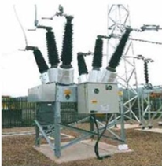




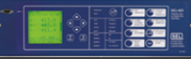



Common Operational Network
Control Room
Outstation
DMZ
WWW
Enterprise Network

Slide 16

Can malware infect the control room or outstation?
Yes
Control Room
Outstation
DMZ
WWW
Enterprise Network

Slide 17
Can malware infect the control room or outstation?
Yes
Control Room
Outstation
DMZ
WWW
Enterprise Network

Slide 18
How do adversaries penetrate the network?
Many networks no security or weak security.
Default passwords.
Poor security implementations.
Often there is no firewall between corporate and control system networks.
Insider attack
Advanced Persistent Threat – ala. Google Aurora
Adversary attacks specific target.
Malware injection via SPAM
Laptops corrupted while off corporate network
at home, travelling, etc.
Planted thumb drives containing malware

Slide 19
Security Needs
Confidentiality
Low priority for most control engineers.
Needed to limit adversaries ability to collect pre-attack intelligence.
Integrity
Authentication, Digital Signature
Stop command and data injection.
Availability
Avoid Denial of Service.
Security solutions must not reduce control system availability.

Slide 20
Security Needs
Traceability
Support post incident analysis (forensics)
Systems already capture control system data
Need to capture network traffic
Commands
Responses
Intrusion Detection
Detect network penetrations
Stop denial of service, port scans
Survivability/Resilience
Survive a cyber-attack
Perhaps at reduced performance level (critical systems must survive)

